Slide 1

EduOpportunityAI: Predicting Student Exam Performance from Lifestyle & Habits
Presented by Muhammad Bilal • December 2025

Slide 2

Introduction: The Multifaceted Nature of Educational Outcomes
Educational success is not solely determined by classroom hours. A complex interplay of lifestyle, social, and economic factors significantly shapes student performance. Understanding these elements is crucial for effective intervention.
1
2
Goal:
Dataset:
Develop an AI/ML model to accurately predict student exam scores based on a comprehensive understanding of their daily habits.
Comprises critical data points including demographics, dedicated study hours, overall health metrics, and social engagement activities.

Slide 3

The Problem: Uncovering Hidden Influences on Academic Performance
Despite similar study efforts, students often exhibit varied academic outcomes. This disparity points to underlying factors beyond traditional metrics, which our research aims to illuminate and address.
Beyond Study Hours
Critical Hidden Factors
Identical study commitments do not guarantee identical results, suggesting other significant variables are at play.
Key elements such as sleep quality, dietary habits, mental well-being, and even internet accessibility profoundly impact learning.
Our Predictive Model
We aim to construct a robust predictive model to empower both students and educators with actionable insights and targeted support.

Slide 4

Dataset Overview: A Holistic View of Student Life
Our custom dataset, meticulously compiled from over 1300 student records, forms the backbone of our predictive analysis, offering a detailed perspective on various influencing factors.
Source: Custom-curated dataset
Records: Over 1300 student entries
Target Variable: Student Exam Score
Features:
Age, Gender
Study Hours, Attendance
Sleep Patterns, Diet, Exercise
Parental Education, Internet Quality
Mental Health Rating, Extracurriculars
This rich blend of categorical and numerical features enables a comprehensive analysis of student performance drivers.

Slide 5
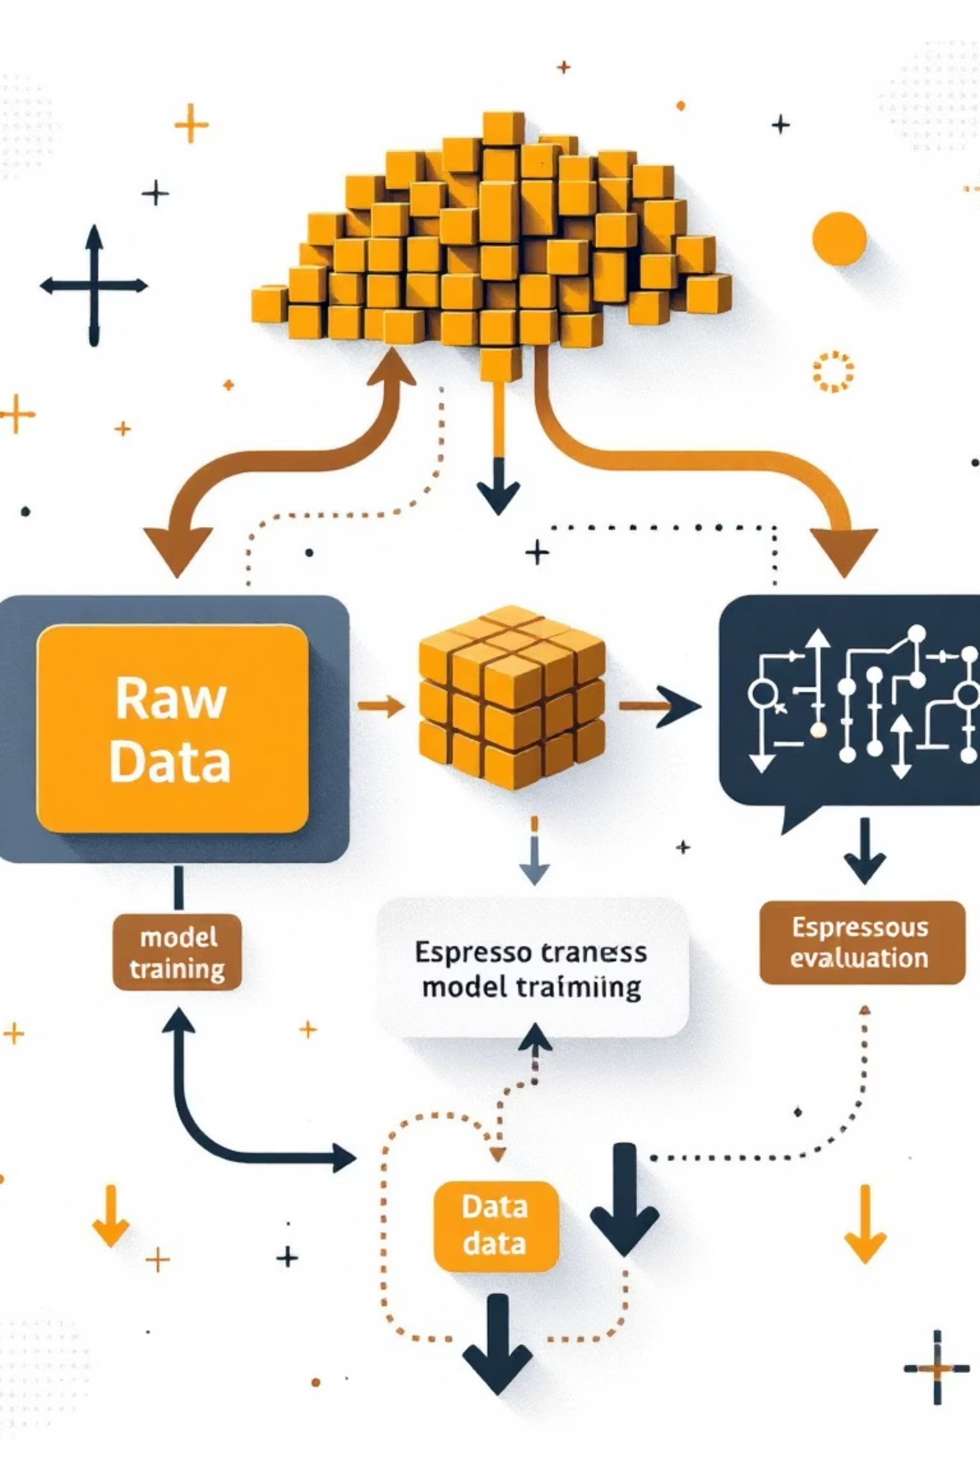




Methodology: Building the Predictive Framework
Our approach involved rigorous data preparation and the application of advanced machine learning techniques to develop an accurate and insightful predictive model.
Data Preprocessing
Categorical variables were encoded, and missing values meticulously handled to ensure data integrity.
Feature Engineering
A refined list of features, drawn from metadata.json, was engineered to maximise predictive power.
ML Models Tested
Evaluated various models, including Regression, Random Forest, and XGBoost, for optimal performance.
Evaluation Metrics
Model efficacy was assessed using standard metrics: RMSE, R², and overall Accuracy.

Slide 6
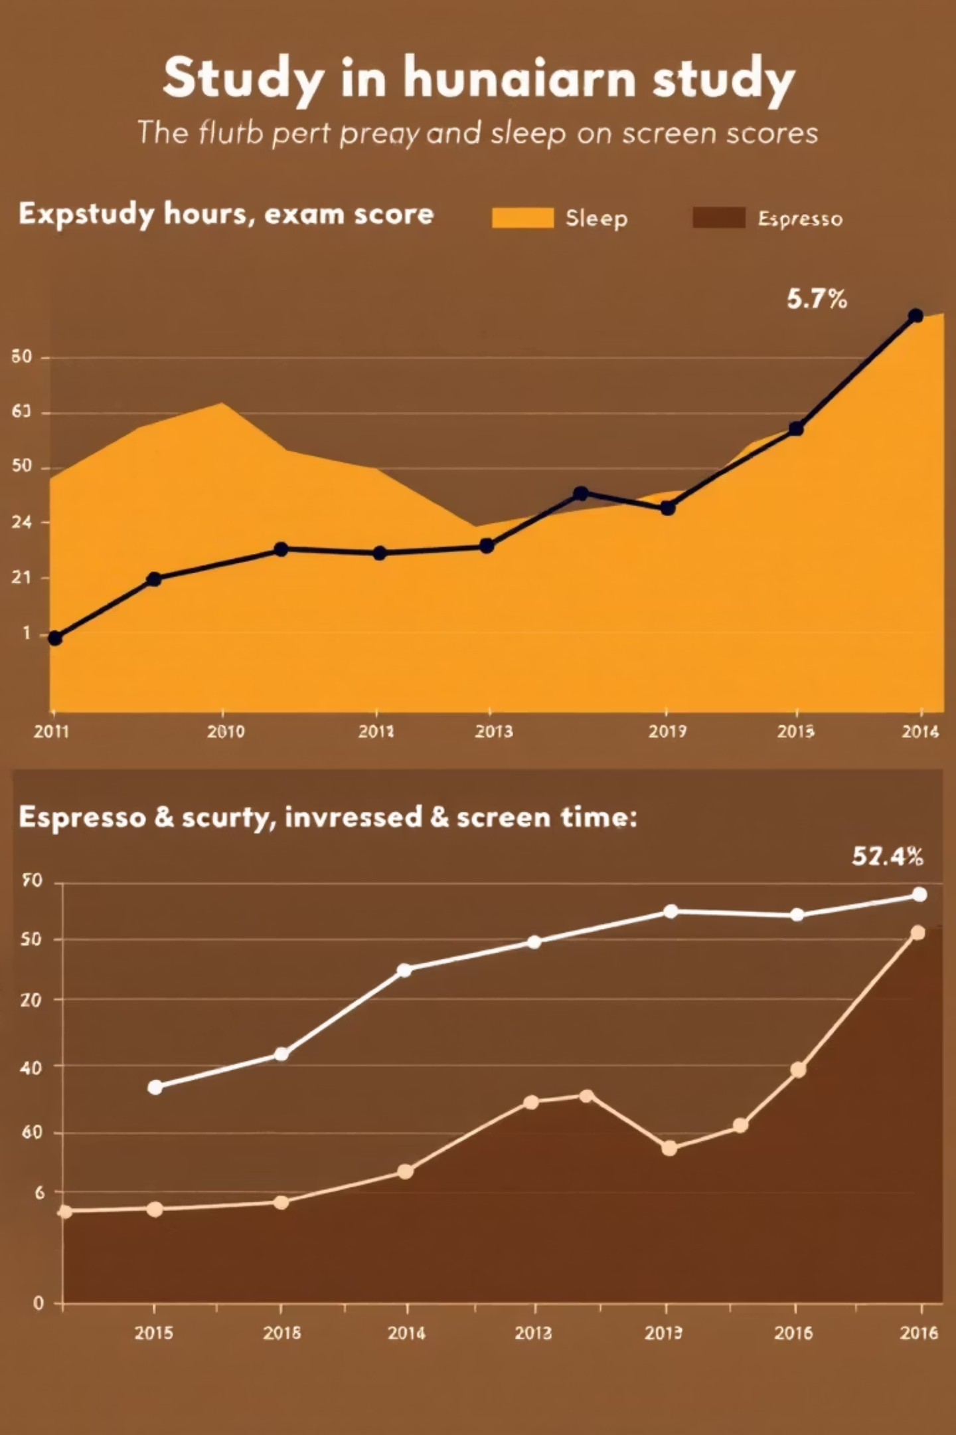




Key Findings: Unveiling Performance Drivers
Our analysis identified several critical factors that significantly influence student exam performance, offering valuable insights for intervention and support.
Strong Predictors
Dedicated study hours, consistent attendance, and high-quality sleep emerged as primary drivers of success.
Negative Impact
Excessive engagement with social media and streaming services correlated with diminished academic performance.
Positive Reinforcers
A balanced diet, regular physical exercise, and parental educational background positively influenced outcomes.
Mental Health Correlation
A strong, statistically significant relationship was observed between students' mental health ratings and their exam results.

Slide 7





Applications: Transforming Educational Support
The insights gained from EduOpportunityAI have profound implications, enabling targeted interventions and strategic policy development to foster student success.
Personalised Study Guidance
Tailored recommendations for students, optimising their study habits based on individual predictive profiles.
Early Warning System
Proactive identification of at-risk learners, allowing for timely support and intervention strategies.
Policy Insights
Data-driven recommendations for educators and institutions to shape more effective educational policies.
Counselling Integration
Potential for seamless integration into existing student counselling platforms, enhancing support services.

Slide 8
Conclusion & Future Work: The Road Ahead for EduOpportunityAI
EduOpportunityAI stands as a testament to the significant influence of lifestyle factors on academic achievement. Our journey continues with ambitious plans for expansion and refinement.
Lifestyle-Performance Link
Confirmation that students' lifestyle choices significantly impact their academic outcomes.
Expanded Datasets
Future efforts will focus on incorporating larger and more diverse datasets for enhanced model accuracy.
Cross-Country Validation
Validation of the model across different educational systems and cultural contexts for global applicability.
Deep Learning Integration
Exploration of advanced deep learning models to capture more complex patterns and relationships.
Vision: AI-Powered Guidance
Our ultimate goal is to establish a comprehensive AI-powered educational guidance system.

Slide 9

Thank You
We appreciate your attention to the transformative potential of EduOpportunityAI.

